Slide 1
Analysis of protein stretching experiments
Optical Tweezers Summer School
Santiago, Chile
11.-15. December 2024
Are Mjaavatten

Slide 2
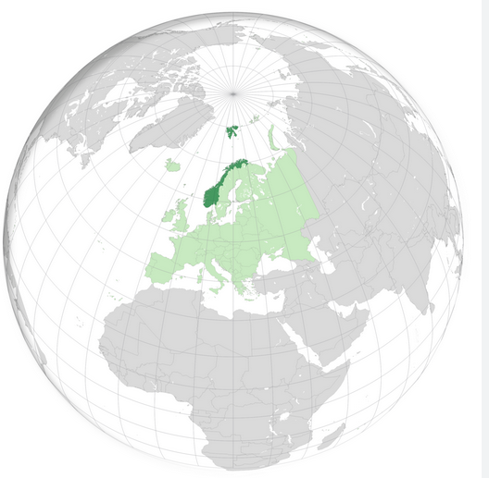
My background
Country: Norway
MSc in physics
PhD in automatic control
Worked in the petroleum and chemical processing industries
Mathematical modelling
Thermodynamics
Part-time professor at what is now The University of South-Eastern Norway

Slide 3
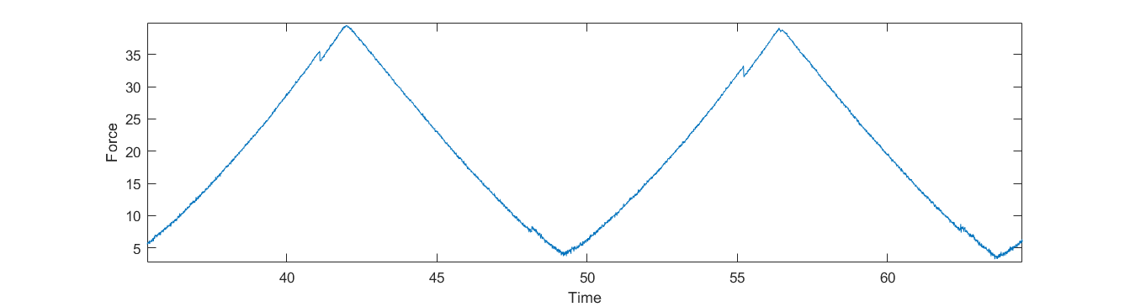
Small part of typical force time series
Rips (unfolding events) and zips (refolding events)
Challenge: Automatically detect and quantify rips and zips
Rip
Zip

Slide 4
Automatic analysis of experiment data Tasks
Read and interpret experiment file
Find individual pull and relax traces
For each trace:
Find candidate rip/zip events
Select best candidate (or reject all)
Calculate rip/zip properties
Inspect results
Remove falsely identified events
Add rips or zips missed by the program

Slide 5
Read and interpret experiment file
Record formats may vary
I use the one from Steve Smith’s apparatus
Other formats may require changes to
read_experiment_file.m
Data read for each record:
Time in seconds or CycleCount: 4000 cycles/s
Force (pN)
Trap position (nm)
Temperature (coded in Status column)

Slide 6
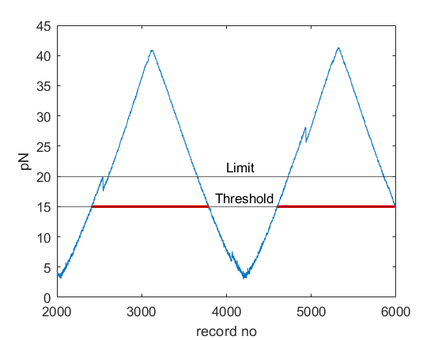
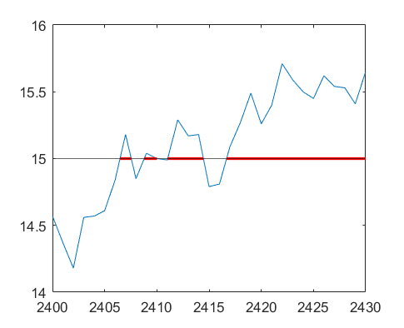
Find individual pull and relax traces
Find all intervals where the force exceeds a threshold (e.g. 15 pN)
Keep only those intervals where the force exceeds a given limit (e.g. 20pN) to eliminate the effect of measurement noise
zoom
Noise

Slide 7
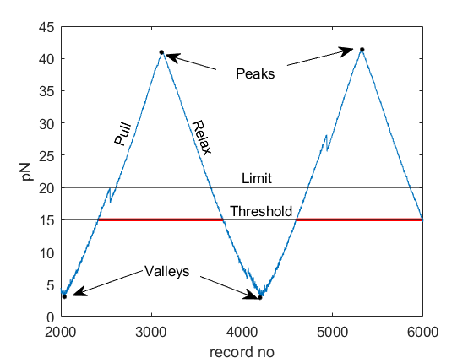
Find individual pull and relax traces (2)
Peakpos: Record no of maximum value in a high force interval
Valleypos: Record no of minimum value of f between two high force intervals
Interval from a valleypos to the next peakpos is a pull trace
Interval from a peakpos to the hext valleypos is a relaxing trace

Slide 8
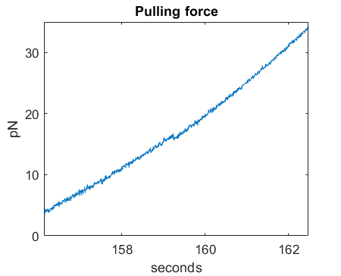
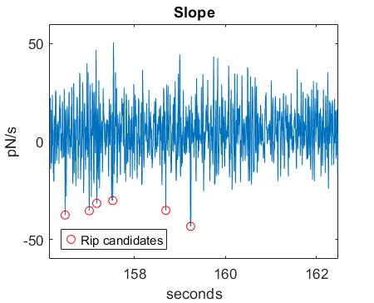
Find rip in a pull trace
Calculate local slope df/dt
A rip shows up as point of negative slope
Check the points with the most negative slope values

Slide 9
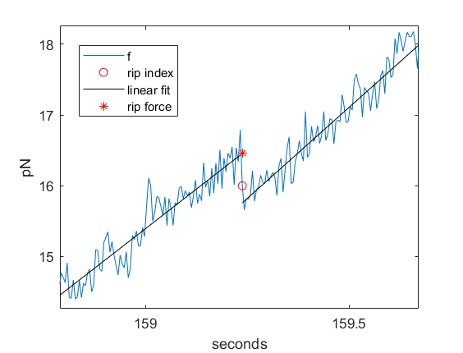
Find rip in a pull trace (2)
Fit straight lines before and after rip candidates
Force shift: distance between lines
Force shift must be larger than signal noise to be valid
Rip force is the fitted value at the rip
Select the valid candidate with the largest shift
(There are more tests and criteria, but let us not get too technical)

Slide 10
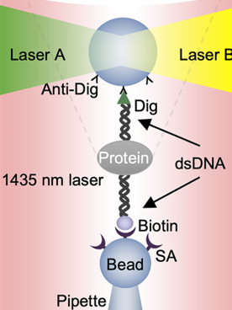
Rip distance Δx

Slide 11
Rip distance Δx
Δx is the difference in trap position at rip force before and after rip.
The length of DNA handles at rip force is the same before and after the rip
Thus, Δx is equal to the difference in protein “length” between the folded and unfolded shapes

Slide 12
Rip/zip properties
Time
Force
Trap position x
Δx
Force shift
Slope before unfolding (df/dx)
Trap pulling speed (dx/dt)
Temperature (optional)

Slide 13
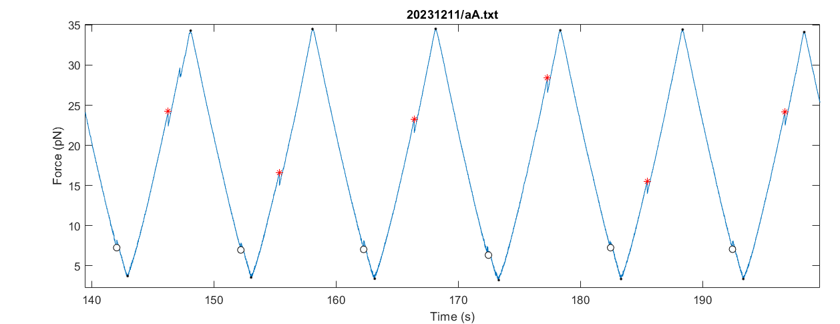
Automatic analysis of experiment data
For “well behaved” data the program works very well

Slide 14
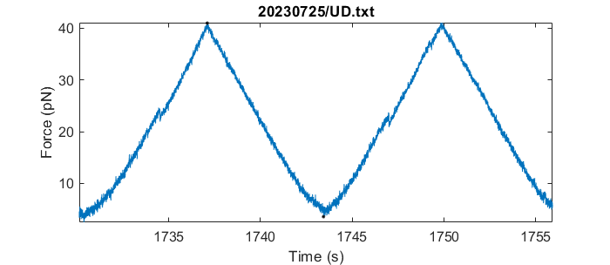
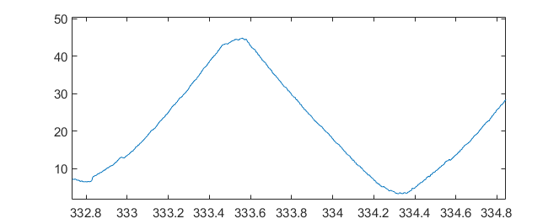
Automatic analysis of experiment data Challenges
Measurement noise
The program fails to find rips here
Weak rips
The program finds rips here

Slide 15
Using Matlab to analyse experiments
Assuming you have already installed Matlab
Or work together with someone who has
Download Matlab files from https://github.com/are-mj/OpticalTweezers
Copy your experiment *.txt files to a folder on your computer
Or use a network folder

Slide 16
Suggested experiment file organisation
I prefer to store the experiment files in one data folder
I use one level of subfolders for storing experiment files.
Subfolders can for instance be named by experiment date.
Create datafolder.m that gives the path
Refer to individual file as e.g . Subfolder1/Aa.txt
Most of my functions automatically add the data folder when needed:
fullfile(datafolder,”Subfolder1/Aa.txt”)

Slide 17
Workflow – single file
Specify your data folder in datafolder.m
Example:
Call analyse_experiment.m
function folder = datafolder
folder = "C:\users\are\data\tweezers";
end
[Trip,Tzip] = analyse_experiment("20231211/aA.txt",1);

Slide 18

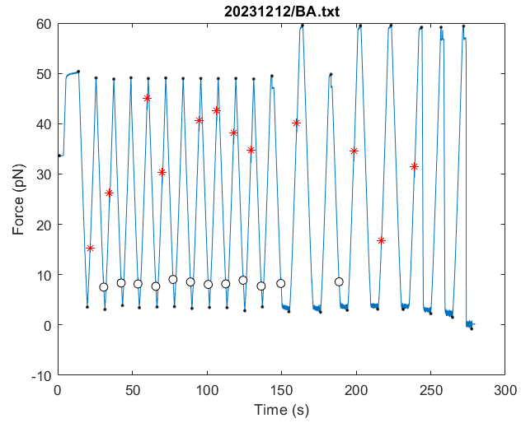

Workflow (continued)
Inspect the plot to see if rips and zips seem correct
Use the axes toolbar:
Zoom
Pan

Slide 19
Matlab results tables Trip and Tzip Contains data for all rip and zip events
Filename
Time
Deltax
Force
Temperature
Forceshift
Trapx Trap position
Fdot Force rate of change
Slope df/dx
Pullingspeed dx/dt
Noise Measurement noise
Timestep Time between records

Slide 20
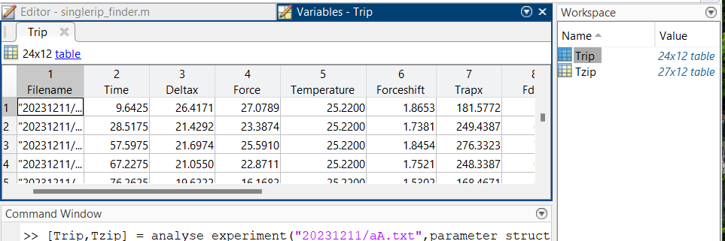
Tables may be inspected in Matlab
or exported to Excel

Slide 21
Exporting results tables Trip and Tzip
Tables may be exported to Excel:
Create a results folder:
resultsfolder = 'C:\Users\are\myresults\’;
mkdir(resultsfolder)
Create subfolder
mkdir(resultsfolder,"20231212")
Create Excel file
writetable(Trip,fullfile(resultsfolder,"20231212/BA.xlsx"),"Sheet","Rips"):
writetable(Tzzip,fullfile(resultsfolder,"20231212/BA.xlsx"),"Sheet",“Zips");

Slide 22
The RipAnalysis Matlab App
Interactive inspection and modification of results
Removal of incorrect rips or zips
Adding missed rips/zips
Plots of f(x) for trace pairs
Removal of irrelevant data at experiment start or end
Storing corrected results tables
Restoring of plots from corrected results

Slide 23
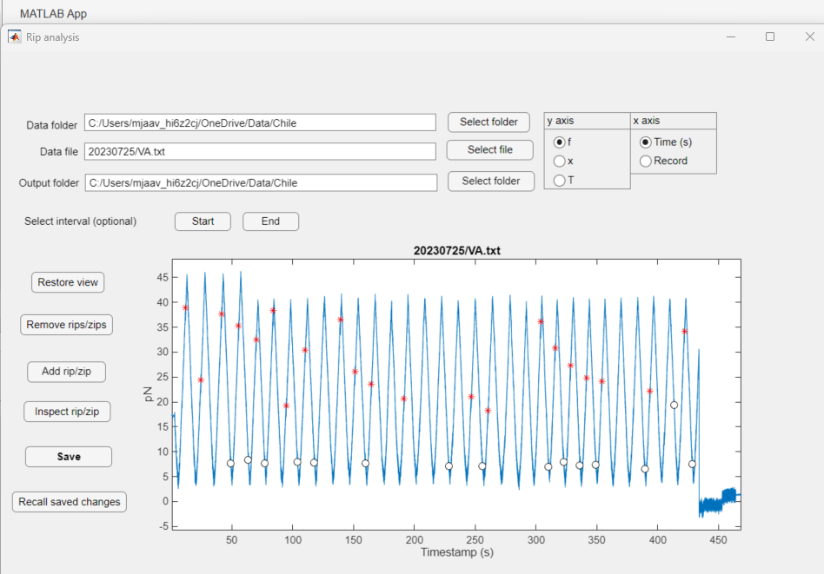

Slide 24


RipAnalysis app
Zoom and pan with the tools
Remove or add rips
Eliminate bad data at start or end
Select variables to plot
Save modified Trip and Tzip tables
Recall changes
After loading original file

Slide 25
Technical details: Naming conventions
Experiment file naming conventions
Fiber (individual protein molecule) named by one or two lowercase letters
Data from a long experiment may be split over several files. Marked by uppercase letters
Bath Temperature
Bath temperature is reported in the COM file as Temperature B.
COM file name is given by the fiber name
aA.txt aB.txt: Data from long experiment using fiber a. COM file: aCOM.txt
abA.txt: Experiment using fiber ab. COM file: abCOM.txt

Slide 26
Combining several files for the same fiber
Results for long experiments on the same fiber are often distributed among several files
E.g. aA.txt, aB.txt, aC.txt, aD.txt, …
Function analyse_fiber(fiber) lets you analyse all files together.
You specify only the subfolder and fiber part
[Trip,Tzip] = analyse_fiber("subfolder1/a");
The files are analysed in alphabetical sequence
Note that the RipAnalysis app and the collect_tables function can so far only handle individual files

Slide 27
Technical details: Extra heating
A separate heating element may increase the chamber temperature above the bath temperature. The setting for this element is recorded in digits 2 and 3 in the status column in the experiment file.
The mapping from setting to temperature increase is given by the table Tlist in the parameter struct.
NOTE: Relevant for Steve’s instrument. Other instruments may handle temperature differently.

Slide 28
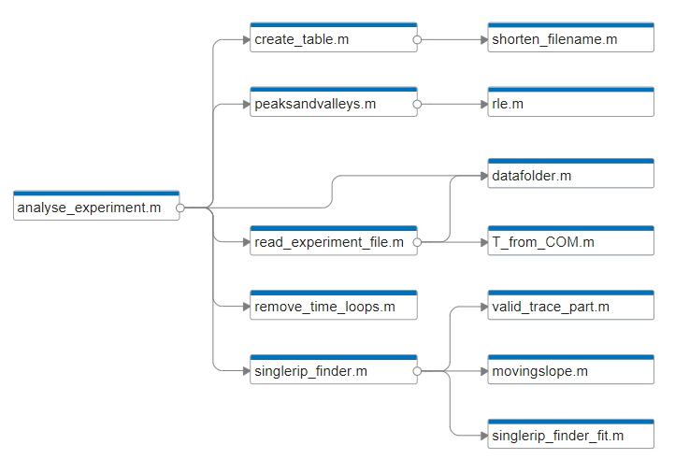
Matlab program structure

